Slide 1
CUSTOMER RETENTION
CHAMLIN NAJIR RAHMAN

Slide 2
PROBLEM STATEMENT
E-retail factors for customer activation and retention: A case study from Indian ecommerce customers
Customer satisfaction has emerged as one of the most important factors that guarantee the success of online store; it has been posited as a key stimulant of purchase, repurchase intentions and customer loyalty. A comprehensive review of the literature, theories and models have been carried out to propose the models for customer activation and customer retention. Five major factors that contributed to the success of an e-commerce store have been identified as: service quality, system quality, information quality, trust and net benefit. The research furthermore investigated the factors that influence the online customers repeat purchase intention. The combination of both utilitarian value and hedonistic values are needed to affect the repeat purchase intention (loyalty) positively. The data is collected from the Indian online shoppers. Results indicate the e-retail success factors, which are very much critical for customer satisfaction.

Slide 3
EDA STEPS
Exploratory Data Analysis.
Here we clean, analyze and visualize the given data, and then draw conclusions.
Step 1 : Importing the required libraries, like numpy, pandas, matplotlib and seaborn.
Step 2 : Importing the excel dataset into jupyter notebook.
Step 3 : Gather information about the dataset, like, columns, shape, datatype, null values, skewness, unique value count for each feature, statistical information using describe(), etc.

Slide 4
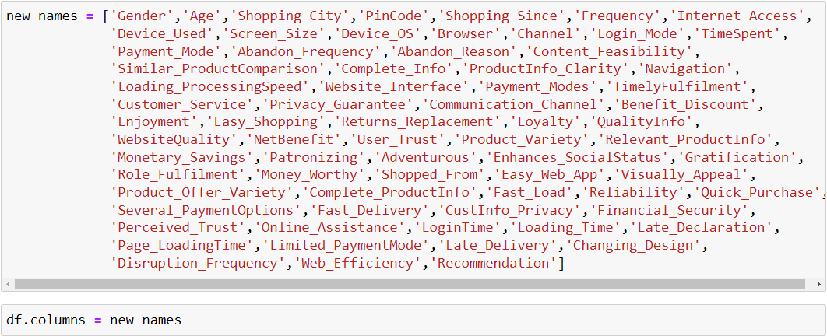
MAIN STEPS :
Column Renaming : In this project first I renamed all the columns, since they were very long and difficult to work with.

Slide 5
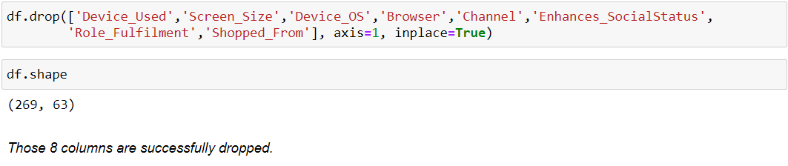
Dropping Columns :
Since I am personally a frequent online shopper, i found some columns not much relevant and can be dropped, which are :

Slide 6
VISUALIZATIONS :
For Numeric Features :
Distribution plot for numeric features, to know their density and distribution of the datapoints.
Swarmplot for numeric features : With swarmplot visualization technique, we are able to view the spread of values in this continuous dataset. Swarm-plot spreads out the data points of the variable automatically to avoid overlap. From here we can observe that most of the datapoints are evenly and closely spread, and hence less chances of outliers.
Boxplot to check for outliers present in the features.

Slide 7
VISUALIZATIONS :
For Numeric Features :
Countplot for all object datatype features, to visualize the count for each category present in these features.
Bivariate Analysis : Finding relation between 2 features.
Example : Factorplot is used mostly in this project to find the relation between two features :

Slide 8
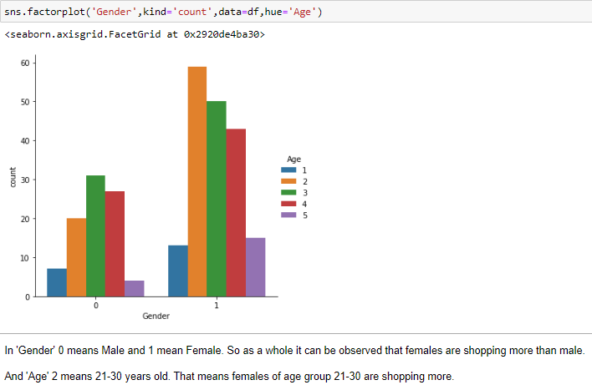
Example

Slide 9
Overall Conclusion :
Amazon and flipkart has a good review overall. Mostly people shop from these two websites and are quite satisfied with their services.

